Slide 1

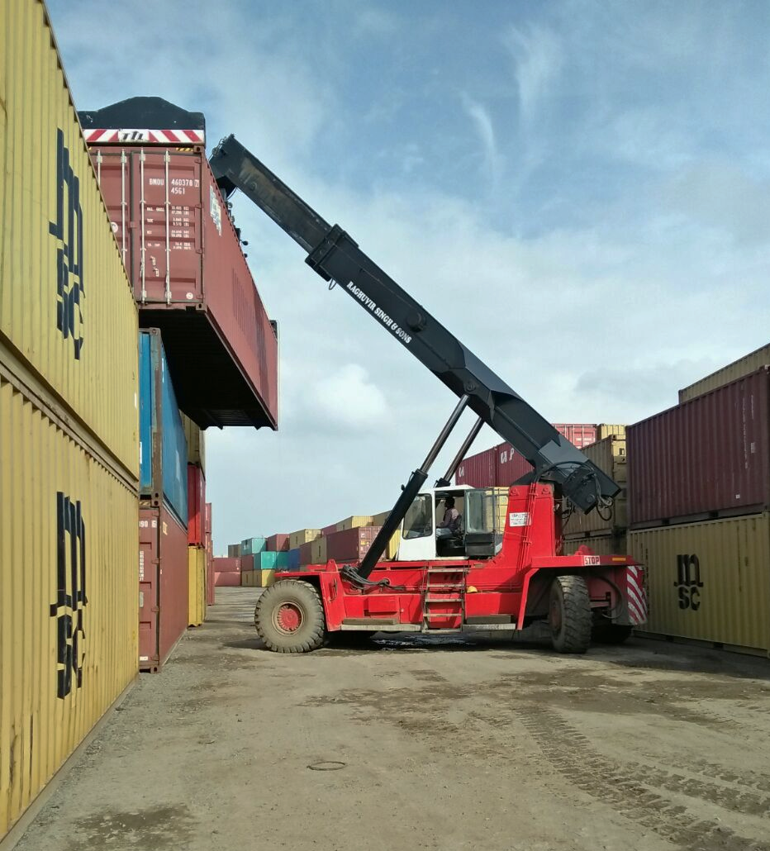
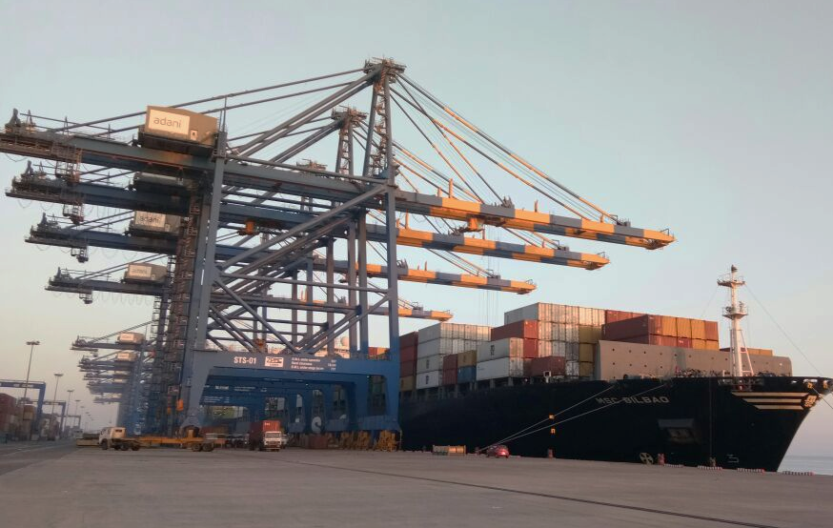
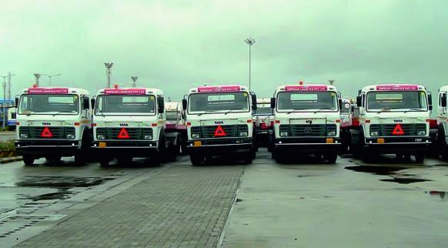
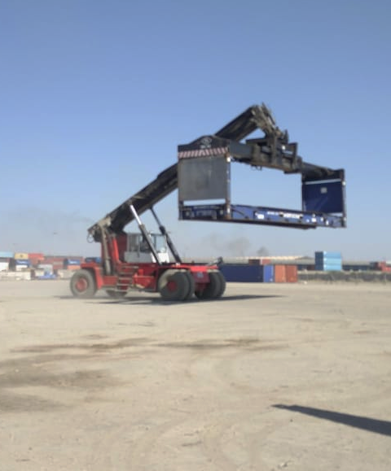
EMPEZAR GROUP

Slide 2
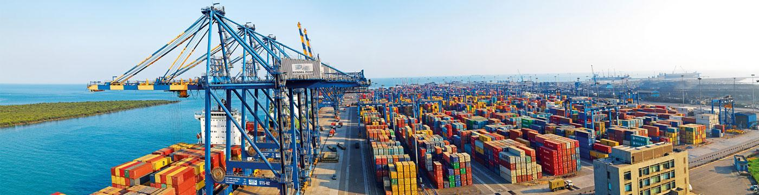
Delivering Excellence in Logistics Solutions

Slide 3
SEZ Warehousing
Consulting Services
Bond Warehousing
The only Integrated Logistics solutions provider at Mundra
And the second largest employer at Mundra Port after the Adani Group.
Technology Solutions
General Warehousing
Empezar
Custom House Broker
CFS
Empty Container Yard
Transport Fleet

Slide 4

The largest SEZ Based Warehouse in Mundra SEZ
Offering advantages such as duty deferment, GST deferment, stock and sell & no late fees for bill of entry filing.

Slide 5

The most commercially viable CFS
Offers the quickest evacuation from the terminals. World class infrastructure, complete transparency and real time reporting. Current clients across Polymer, Heavy Machinery, Cosmetics, Timber, Paper, Bitumen & Oil Rigs

Slide 6
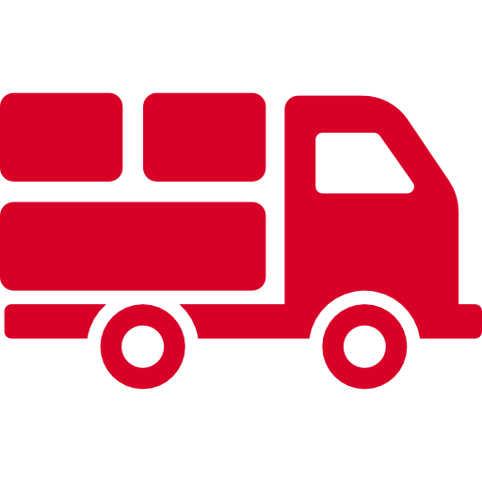
The largest transportation fleet within Mundra SEZ
Over 240 Trailers. Manage the Container Operations of all 4 Terminals at Mundra Port. Handle 350,000 TEUs/month – the highest in India. In-house maintenance facilities which minimizes down time.

Slide 7

The Largest Empty Container Yard
Handle over 130,000 TEUs a year. In-house Maintenance and Repair. Systems support Container Location, Barcoding and Real Times Updates for customers.

Slide 8

Pathbreaking Technology Solutions
Support advanced reporting mechanisms for customisable real time reports. Deployed technology solutions for leading Shipping Lines & Logistics Companies.

Slide 9

One of the most reputed Custom House Brokers
With retired customs officials leading an enviable team of professionals. Our Clients are in the Top 3 Importers in Mundra in terms of Duty Payment

Slide 10


Service & Compliance
Corporate office in Gandhidham for regular Customer Interactions. All facilities compliant of the Statutory Rules and Regulations and accredited with the relevant certifications and permissions.

Slide 11
MUNDRA

Slide 12
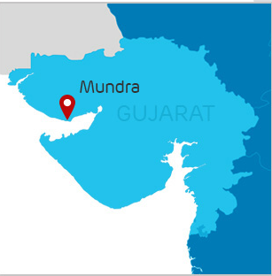



Mundra, the right port for many reasons
Strategically located, Mundra is a natural gateway to the cargo hubs in Northern and Western India – bringing down logistics costs
6 Railway lines for handling Container Trains & 10 Railway lines for Bulk cargo offer unmatched connectivity
A deep draft, all-weather port & India’s largest commercial port. Mundra can berth the largest post panamax vessel and can handle four million TEUs

Slide 13
Brief History

Slide 14
Built on the twin pillars of ‘transparency’ & ‘trust’
The Empezar Group was incorporated in 2008 and since then has spread its wings into various lines of the logistics industry - Port Transportation, Empty Container Yard, Warehousing, Customs Cargo Clearance, Freight Forwarding, Technology Solutions and Total Logistics.
Empezar has a vision to become a leading integrated logistics solutions provider, on the backbone of a powerful technological platform to deliver customer delight.
In a short span, Empezar has built robust relationships with Shipping Lines and Clients alike. We have operations in Mundra & Hazira; and offices at Gandhidham, Mumbai and Delhi.

Slide 15
Services

Slide 16
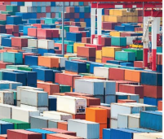
SEZ Warehousing
The concept of warehousing of goods in a duty-free area (SEZ) has emerged as a key factor in logistics and global supply chain system servicing.
Mundra has rapidly emerged as a leading international trading hub, owing to superior infrastructure and its strategic location – cargo consolidation and distribution to the Indian sub continent, South East Asia, Middle East, CIS and Africa.

Slide 17
SEZ Warehousing
Economic
Non-Economic
Duty Deferment A. The goods can be stored in the warehouse without payment of Customs Duty B. If the goods are sold outside India, there is no customs duty payable
Tax Benefits A. A foreign company will not fall within the ambit of Income Tax Act B. Special Auxiliary duty is not payable at the time of import. In certain cases, it is required to be paid at the time of clearance in the domestic tariff area C. Service tax benefits
Nominal Overhead Costs A. The foreign company does not have to have an establishment in India. The warehouse keeper, on authorisation by the importer can carry out all legal formalities.
A. The custom checks and procedures are minimal and the environment is trade-friendly.
B. The foreign company does not have to open a company in India and go through all the cumbersome formalities like IEC Code
C. There is no time limit for keeping the goods in the bonded warehouse as it is in the case of normal bonding in India. The only requirement is that warehousing charges have to be paid in foreign exchange.
D. Facility to stock and sell
We have the facility to provide over 50,000 SQM of warehousing space [covered & open] in and around Mundra and also have the capability of constructing a warehouse for a specific requirement.

Slide 18
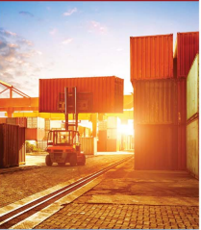
Container Freight Station
An approved Container Freight Station and a Bonded Warehouse, along with our other services help us provide Total Logistics Solutions to clients.
Today we are partnering with some of the largest players across industries - Heavy Machinery, Cosmetics, Paper, Bitumen, Oil, Timber to name a few. Our systems driven approach ensures the highest level of services to ensure customer delight.

Slide 19
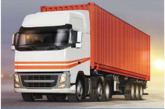
Transportation
Our company handles the local transportation of container and body trucks for export and import movement of our esteemed clients. We are able to offer this kind of service to all parts of India through our network of esteemed agents and sub-agents
Our dedicated team of supervisors and trained mechanics ensure a high uptime of our fleet.

Slide 20
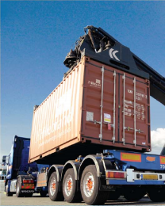
Custom House Broker
We operate as Licensed Custom House Agents at all western ports of India. We are also present at various ICDs and CFS’ situated at all major locations.
We are capable of handling cargo consisting liquid, bulk, break bulk, project cargo & containerized cargo.
We have customs-approved trained & experienced staff to deal with customs port related matters and to provide excellent services.

Slide 21
Empty Container Yard
The largest and most efficiently run Empty Container Yard in Mundra SEZ. A one of its kind technological interface ensures transparency of rates, on time performance and adherence to the highest quality standards.
With world class infrastructure, a large trained workforce and systems which support Location tracking, Barcoding and Real Times Updates for customers – Empezar is the preferred partner for some of the largest shipping lines in the country.

Slide 22
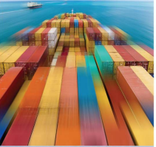
Technology Solutions
Empezar has a large in-house technology team that has built a reputation for creating pathbreaking software solutions for the logistics Industry. Our solutions have led up to a 50% increase in efficiencies for some clients.
We are working with global shipping lines and reputed logistics players to build systems that dramatically change the way they do business.

Slide 23
Our Technology Stack
.NET Core
Android / IOS
Mysql / SQL
Google Cloud Platform / Services
Angular 6+ / TypeScript / NodeJs
Python
PHP
React Native
Flutter
Firebase / Firestore
BigQuery / Analytics
RPi , Arduino , PCB , Embedded Electronics
IOT
Augmented Reality / Virtual Reality

Slide 24
Thank You

